Slide 1
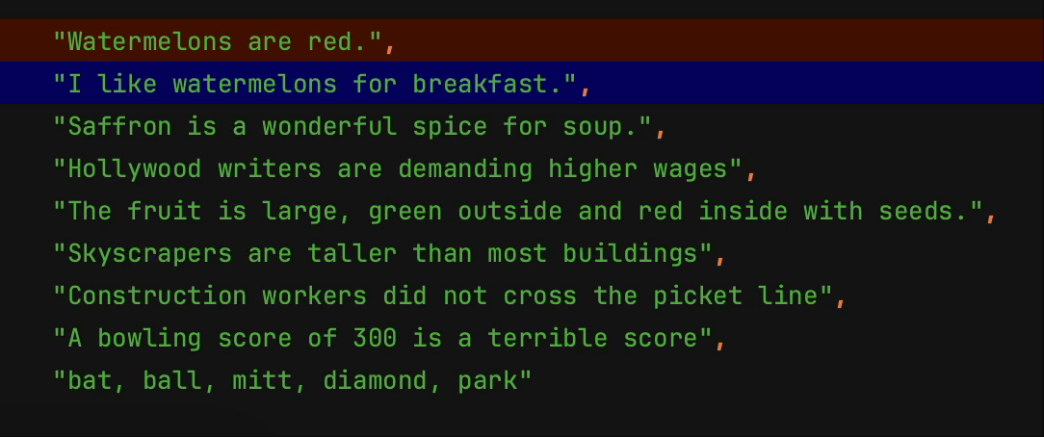
Documents

Slide 2
Themes

Slide 3
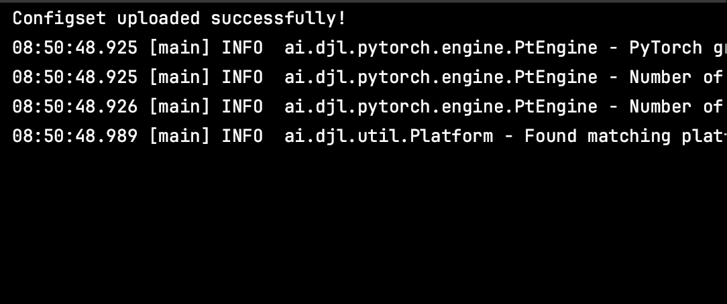
Search examples

Slide 4
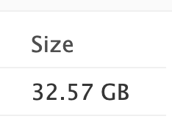

Expanding to the ms-marco set
Microsoft ms-marco dataset
3.2MM documents, takes up 32.57GB for text and vectors

Slide 5
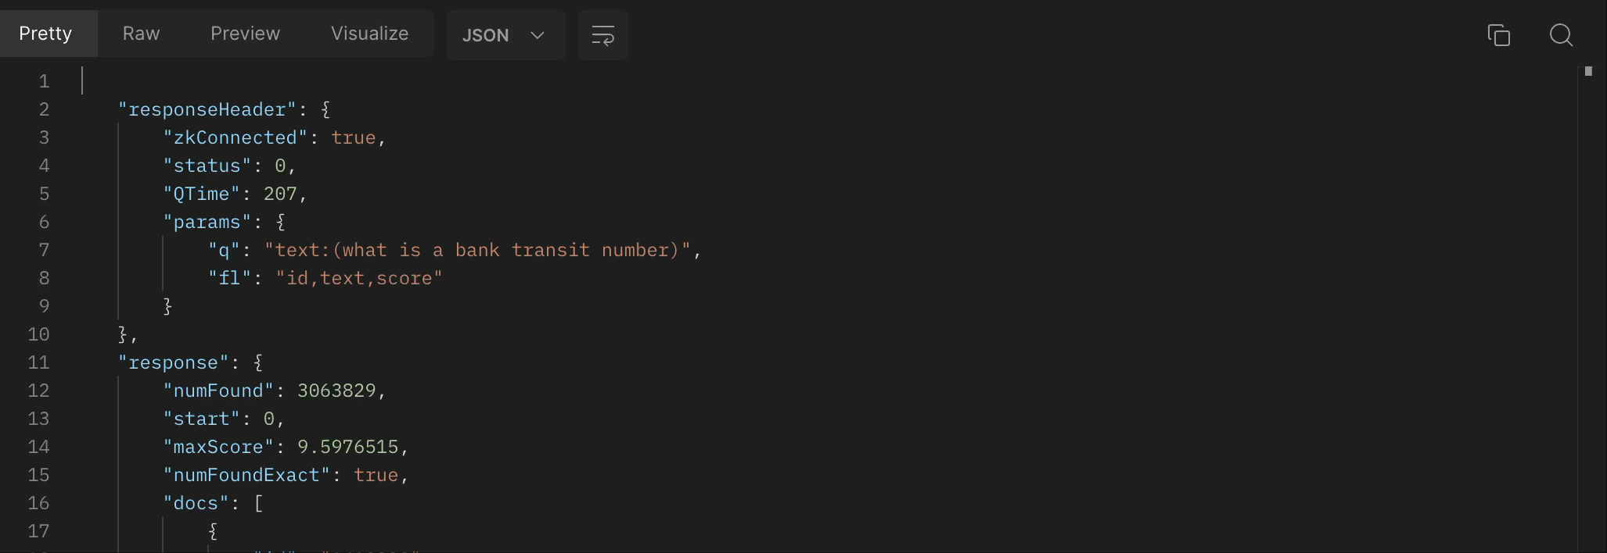
Searching ms-marco

